Slide 1

Flow state
Idea is 1000s of years old
Named by Mihaly Csikszentmihalyi
Subject of ongoing research

Slide 2
What is it?
State of intense concentration.
  Connections between ideas come more easily
  Lose track of time
  Lose ego and sense of self
  Ignore body, food, sleep

Slide 3
What happens
Neurological changes
  “Hypo frontality” - prefrontal cortex slows down.
  “You get norepinephrine, dopamine, anandamide, serotonin and endorphins. All five of these are performance enhancing neurochemicals.”
  https://bigthink.com/surprising-science/steven-kotler-flow-states/
Happiness
  “My mental health has a relationship with how often I can experience flow”
  https://play.acast.com/s/blindboy/talking-to-a-psychologist-about-creativity

Slide 4
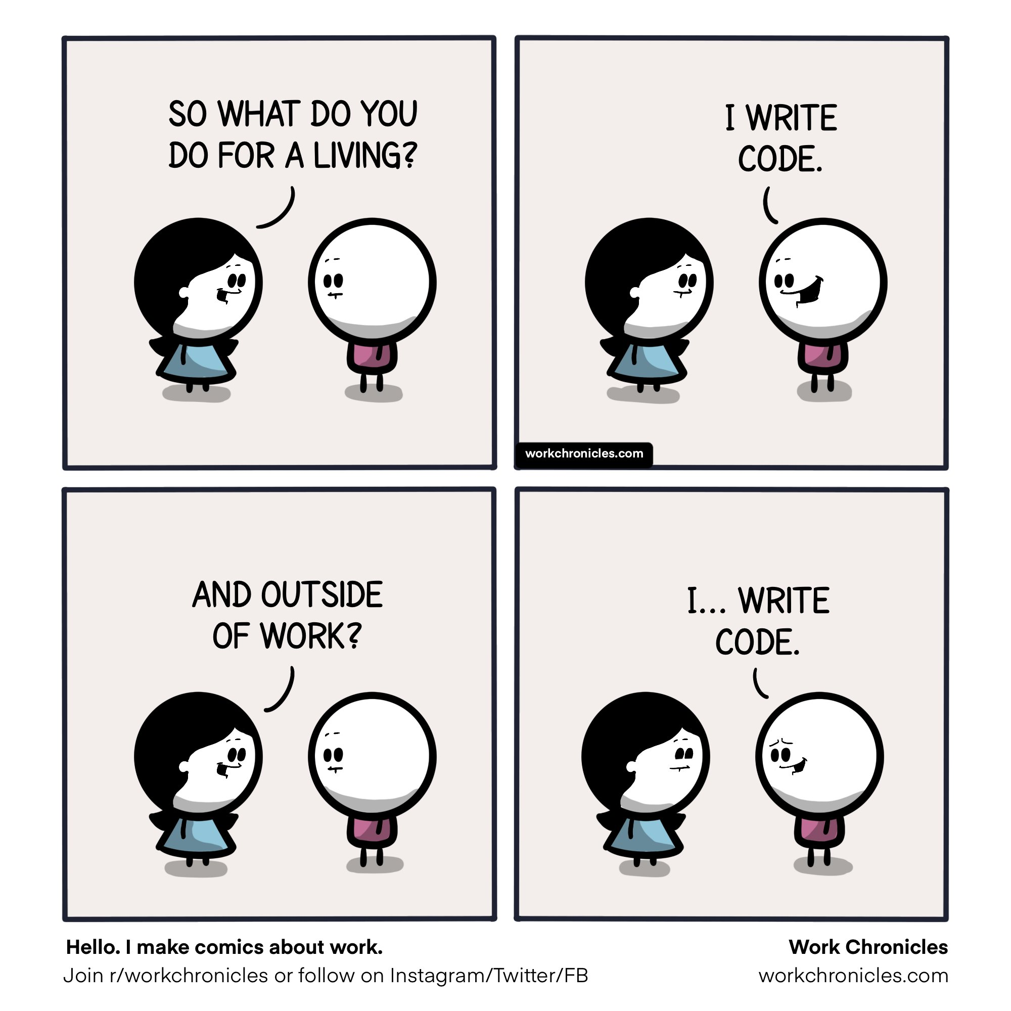

Slide 5
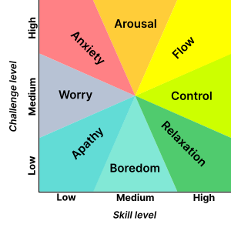
Good for flow state
Instrinsically rewarding task
Clear goals and sense of progress
Immediate feedback
Challenge & skill level both high

Slide 6
Bad for flow state
Discomfort (cold, noise, hunger, etc)
Fear of failure
Unclear goals
Slow feedback
Being exhausted
I learned never to empty the well of my writing, but always to stop when there was still something there in the deep part of the well, and let it refill at night from the springs that fed it.” - Ernest Hemingway

Slide 7
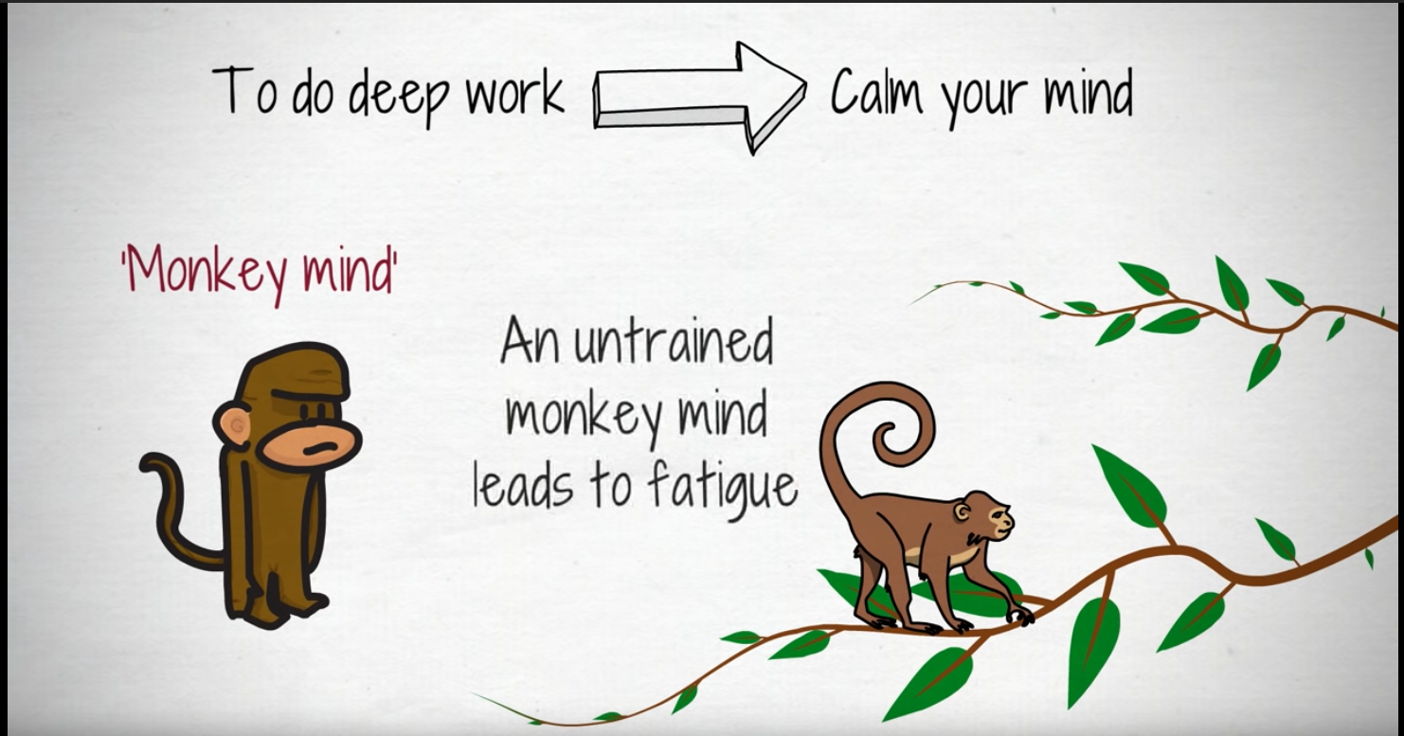



Distractions and interruptions
From “The Art of Improvement”
https://www.youtube.com/watch?v=eqZCqelBPG0
Twitter without Infinite Scroll
https://addons.mozilla.org/en-US/firefox/addon/t-w-i-s/
Avoid interruptions that bring uncertainty / worry.
“Hello, what’s your opinion on ticket 1535,
should we prioritize it?”
“Can you help me understand this change? I thought
we would do X, but it we did Y.”
https://codethink.cdth.io/process/process.html#on-interruptions
“ping”
“Do you have 5 minutes?”

Slide 8
The double edged sword
I spent 4 hours in deep concentration making a thing to do X … then I realised we need to do Y.
Standups
Monologue on IRC / issue tracker.
Regular breaks

Slide 9
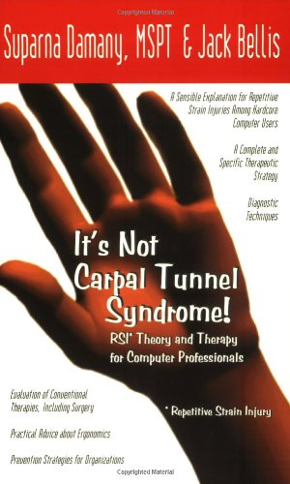
Losing sense of body is bad
Eyes can become strained
Muscles holding same position become hardened, and trap your nerves in place.
Physiotherapy can only fix so much!
Regular breaks… but how?

Slide 10

How can regular breaks coexist with creative flow?
Be conscious of body.
  Breathing
  Close eyes tightly
  Notice tension and release it
“Don’t use your mind for storage”
  Think beyond code: Plans, diagrams, task lists, questions, etc. etc.
    These things can be done away from laptop: café, park bench, etc.
  Use issue tracker / wiki to record these things
    Also good teamwork
Be conscious of mind.
  Dopamine for the monkey brain.
  Notice when you’re reluctant to take a break and consider why.
What else?

